Slide 1
Knowledge, evidence, and errors in thinking
(Chapter 4)
Bobir Muratov

Slide 2
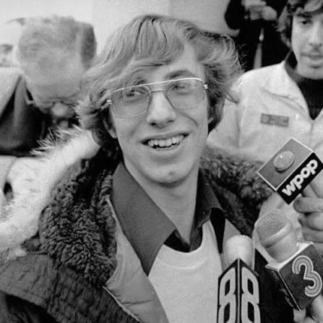
Introduction
The case of Peter Reilly

Slide 3
What’s to Come
Human Knowledge and Its Limitations
Evaluating Evidence
Cognitive and Perceptual Errors in Thinking
Social Errors and Biases

Slide 4
Human Knowledge and Its Limitations
Knowledge – information or experience that we believe to be true and for which we have justification or evidence
Rationalists claim that most human knowledge comes through reason
Empiricists claim that we discover truth mainly through our physical senses (a.k.a. empirical evidence)
Kant and current psychologists – our mind provides structure and rules for processing incoming information

Slide 5
Evaluating Evidence
Evidence – smth. that tends to prove or disprove a claim
Direct experience
False memory syndrome – the recalling of events that never happened
Hearsay – evidence that is heard by one person and then repeated to another
Anecdotal evidence – evidence based on personal testimonies

Slide 6
Evaluating Evidence
Experts and credibility
Expert credentials we should look for:
Education
Experience
Reputation
Accomplishments
Is expert testimony foolproof?

Slide 7
Evaluating Evidence
Evaluating evidence for a claim
Confirmation bias – the tendency to look only for evidence that supports our assumptions
Research resources

Slide 8
Cognitive and Perceptual Errors in Thinking
Perceptual errors
Check https://michaelbach.de/ot/
Misperception of random data
Memorable-events error – involves our ability to vividly remember outstanding events
Probability error – misunderstanding the probability or chances of an event by a huge margin

Slide 9
Cognitive and Perceptual Errors in Thinking
Self-serving biases:
Misperception that we are in control
Tendency to overestimate ourselves in comparison to others
Tendency to exaggerate our strengths and minimize our weaknesses
Self-fulfilling prophecy – when our exaggerated or distorted expectations reinforce actions that actually bring about the expected event

Slide 10
Social Errors and Biases
“One of us/one of them” error – classifying people
Societal expectations, ex., stereotyping
Group pressure and conformity, ex., groupthink
Diffusion of responsibility – when in a large group, we may regard a problem belonging to someone else

